Slide 1

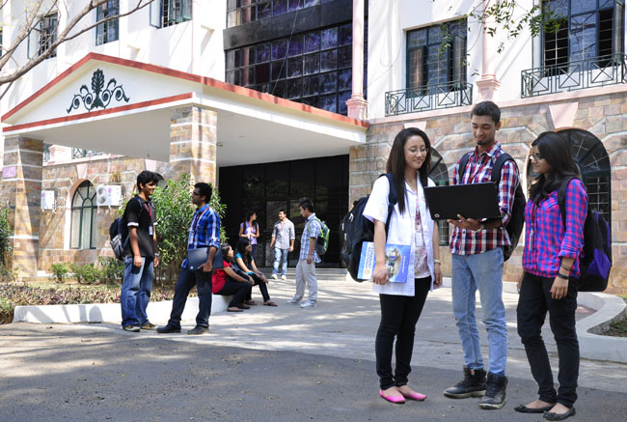
DEPARTMENT OF COMPUTER SCIENCE AND ENGINEERING
EMPLOYEE DATABASE MANAGEMENT SYSTEM
PRAGADEESHWARAN O[22138009]

Slide 2
AGENDA
INTRODUCTION
OBJECTIVE OF THE PROJECT
MODULES
PROPOSED SYSTEMS
SOFTWARE REQUIREMENTS
PERFORMANCE TESTING
RESULTS AND OUTPUTS
CONCLUSION
REFERENCE

Slide 3
INTRODUCTION
It is a python based program which can be used to manage employees and their details.
Employee management system is essential software designed to keep track of employee's information in any organisation.
It stores data such as employee's personal information.
The goal of the employee management system is to create a workcenter scheduling system. It stores both official and personal details.
The Employee Management System is a cloud-based software and it has many applications. Such as Employee registration ,Viewing employee records, Deleting a existing record and modifying a existing records
IoT-based employee database management systems can offer significant benefits to businesses, including real-time data, enhanced security, improved productivity, and reduced costs.

Slide 4
OBJECTIVE OF THE PROJECT
User can add their Employee’s details safely and it’s not time consuming. This System makes easy to store records of each and every employees.
The primary obejective of this system to collect, store, organize, retrieve and make the information available to the users.
It saves lots of time and work and reduces the hassle of managing records.
This system eliminates the physical storage and management of system and makes it easier.
It also automates the entire process.
This also increases effectivity.
The records can also be retrieved if wanted easily without much of a hassle
IoT-based employee database management systems can offer enhanced security

Slide 5
FRONTEND AND BACKEND
Here we have 2 option, one is the creating login id and password another one is directly login our id using our id and password
Creating login id we have to give input like first name ,last name, user name, password
Login id we have to put our user name and password, if it’s match mean it go to next modules
For above process we use two function, while loop and if else. overall we combine all of this in one main function
This at all include in modules 1.in that module all got true means then it goto the next module

Slide 6
BACKEND
In module 2 we create employe details by getting input from user like employee id, name, post, salary
If the employee id already exists mean loop will terminate and said already exists
Here what are inputs we given that all are store in our local database using sql
We import sql connector to store data in local database
Command for store data in sql
sql = 'insert into empd values(%s,%s,%s,%s)'

Slide 7
FRONTEND
Here we able to delete the employe details by choosing remove option and give the employee id
Promote employee salary by easily add how much increament we need
Display employee details using to show all of employee details
We create for each of things in separate function
def Add_Employ():
def Promote_Employee():
def Remove_Employ():
def Display_Employees():

Slide 8
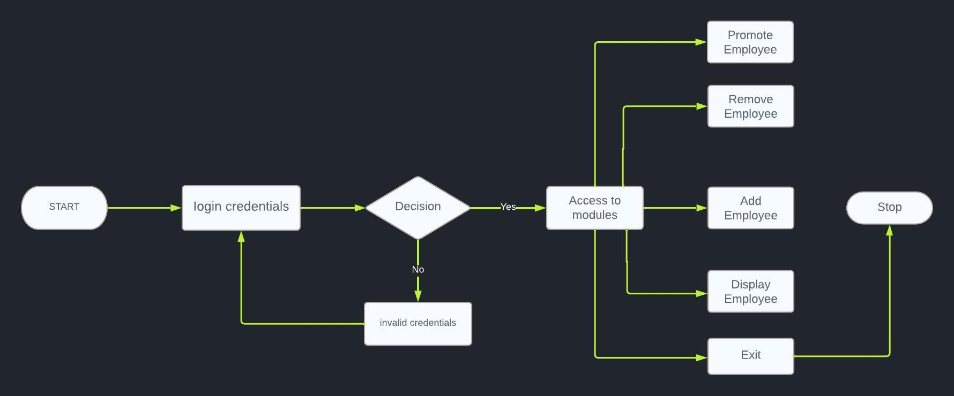
PROPOSED SYSTEMS

Slide 9
SOFTWARE REQUIREMENTS
Operating System : Windows XP Professional.
Coding Language : M-Script.
Database : Local Database.
Software Tool : MATLAB.
HARDWARE REQUIREMENTS
Hard Disk : 80 GB RAM : 256 MB (min), 1 GB (max)
Processor : intel i5
Monitor : 17” color monitor
Keyboard : USB Keyboard
Mouse : USB Optical mouse
Speed : 4.30 GHZ (max)

Slide 10
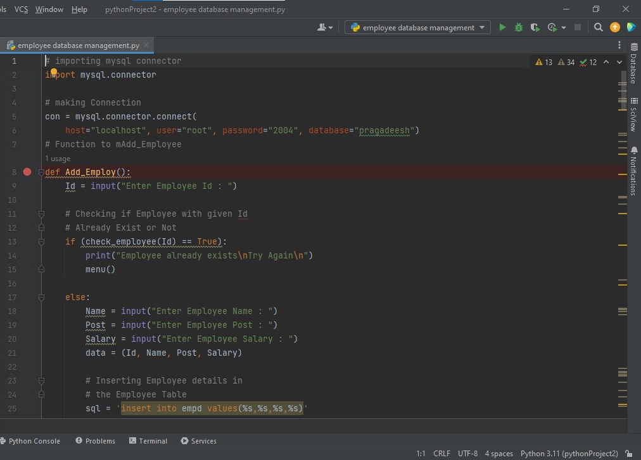
PERFORMANCE TESTING

Slide 11
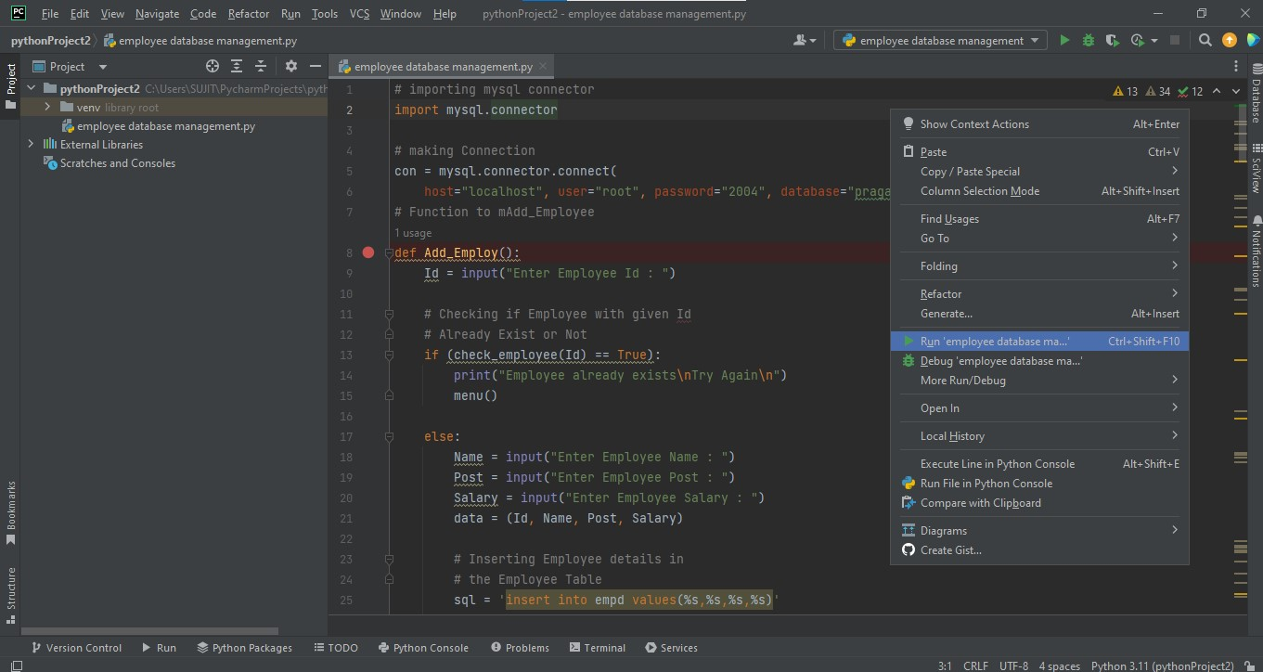
PERFORMANCE TESTING

Slide 12
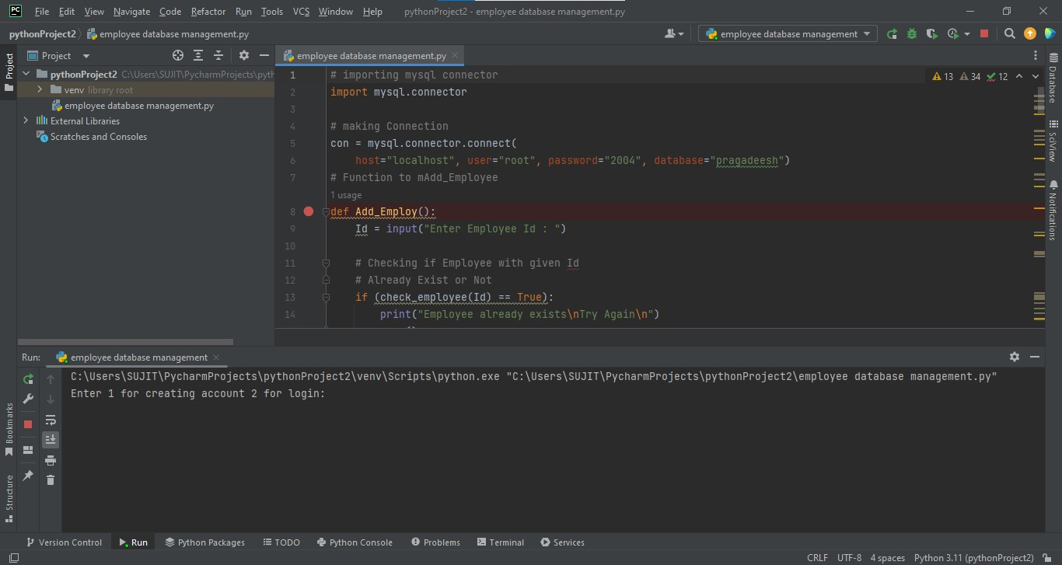
RESULTS & OUTPUT

Slide 13
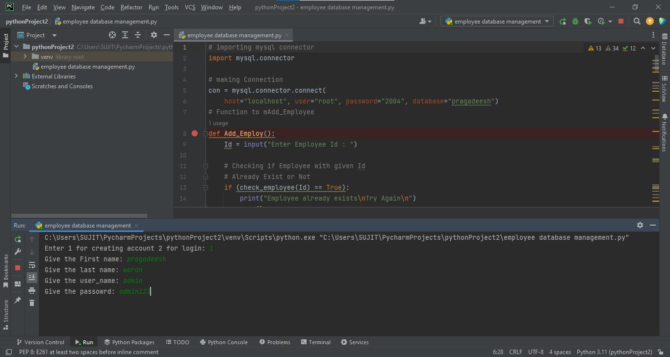
RESULTS & OUTPUT

Slide 14
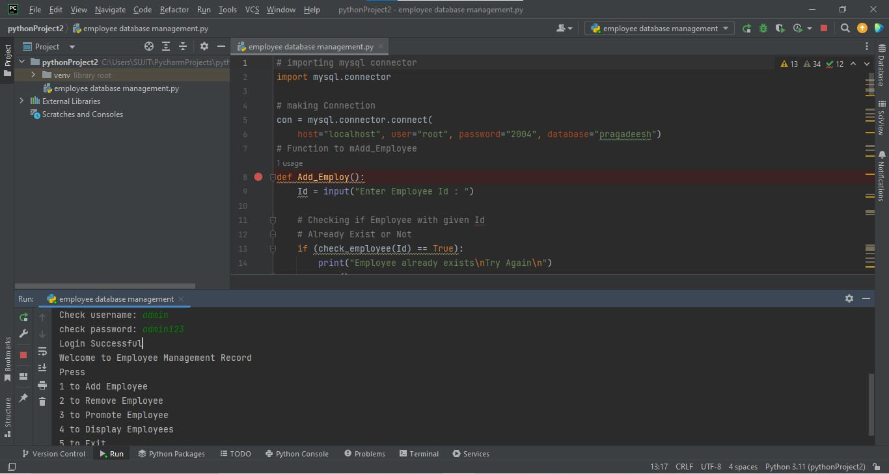
RESULTS & OUTPUT

Slide 15
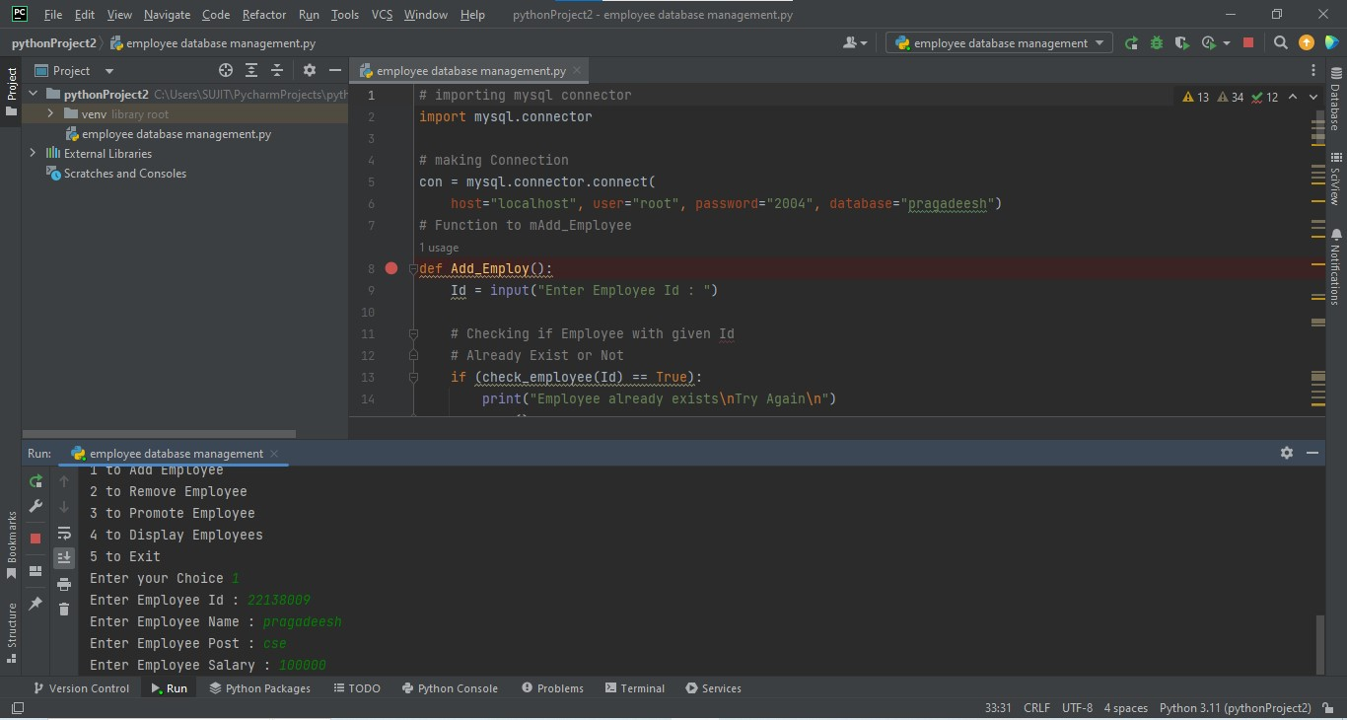
RESULTS & OUTPUT

Slide 16
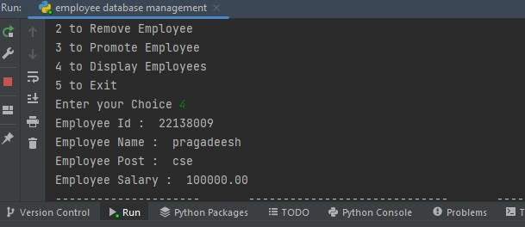
RESULTS & OUTPUT

Slide 17
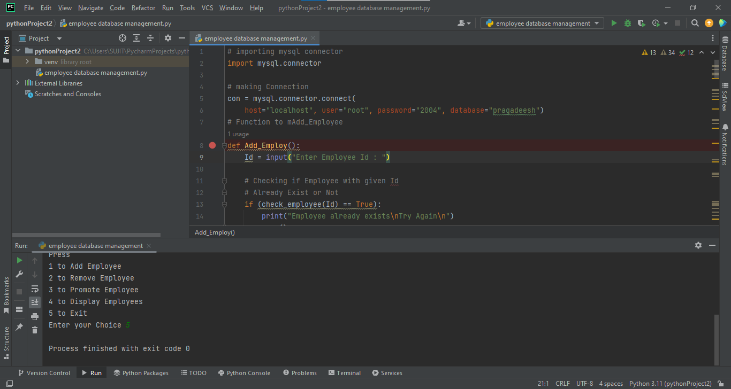
RESULTS & OUTPUT

Slide 18
CONCLUSION
The idea is that we perform different changes in our Employee Record by using different functions for example the Add_Employee will insert a new row in our Employee, also, we will create a Remove Employee Function which will delete the record of any particular existing employee in our Employee table.
This System works on the concepts of taking the information from the database making required changes in the fetched data and applying the changes in the record which we will see in our Promote Employee System.
We can also have the information about all the existing employees by using the Display Employee function.
The main advantage of connecting our program to the database is that the information becomes lossless even after closing our program a number of times.
IoT-based employee database management systems can contribute to energy efficiency initiatives within the organization.
It's important to implement appropriate security measures when integrating IoT into employee database management systems to protect employee data and ensure compliance with privacy regulations.

Slide 19
REFERENCES
[1] – Begg Carolyn, Connolly Thomas, Database systems (a Practical approach to Design, Implementation, and Management), Addison-Wesley, an imprint of Pearson Education, University of Paisley (U.K.), Fourth edition 2005
[2]-http://msdn.microsoft.com/library/default.asp?url=/library/en-us/vbcon/html/vboritextboxctltasks.asp (2006-05-25).
[3] – Dawen Ding, Zhiqiang Zhao, The Design of University Staff Data Management System Based on MBSE, 10.1109/ICIEA48937.2020.9248413, 09 November 2020
[4] – Joydip Sarmah, Nelson R Varte, Sanjay Jyoti Dutta , Human Resource Management System: A case study on an Information Management Design,December 2018,DOI:10.1109/ICINPRO43533.2018.9096835
[5]-Bodnar George /Duquesne University/, Hopwood William /Florida Atlantic University/, Accounting Information systems, Eighth Edition, Prentice Hall, Upper Saddle River, New Jersey .

